Slide 1
Introduction to P4
22nd Feb 2025 @ 10.30am(MY)/9.30am(LA)/9.00am(MM)
CHOI MENG HUI
University of Malaya Graduate

Slide 2
Content
Part 1 - Introduction to P4
Part 2 - Hands-on Lab

Slide 3
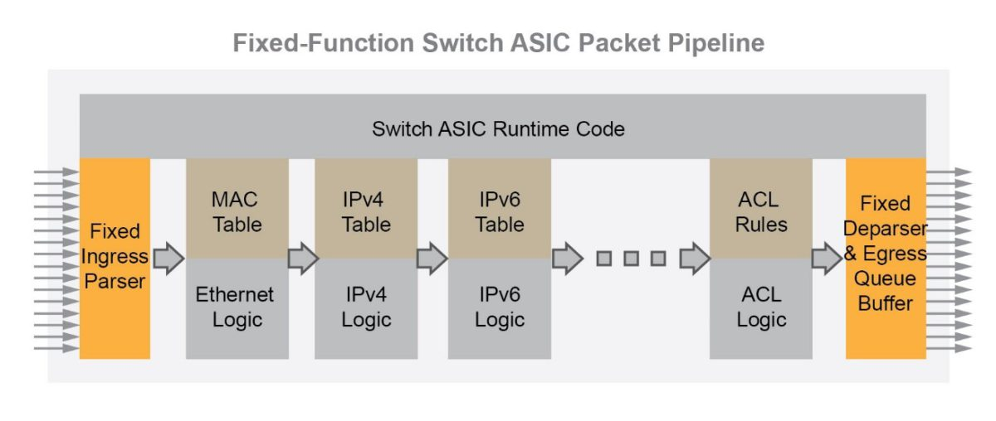
Traditional network switch
Vendor defined
Packet processing logic based on vendor developed

Slide 4
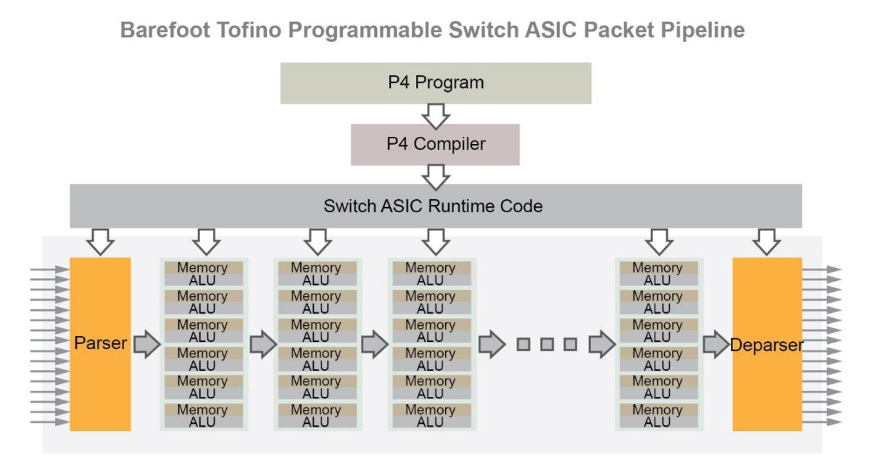
Programmable Switch
each stage of the packet pipeline is undefined and requires programming for packet parsing and specific match-action forwarding logic.

Slide 5
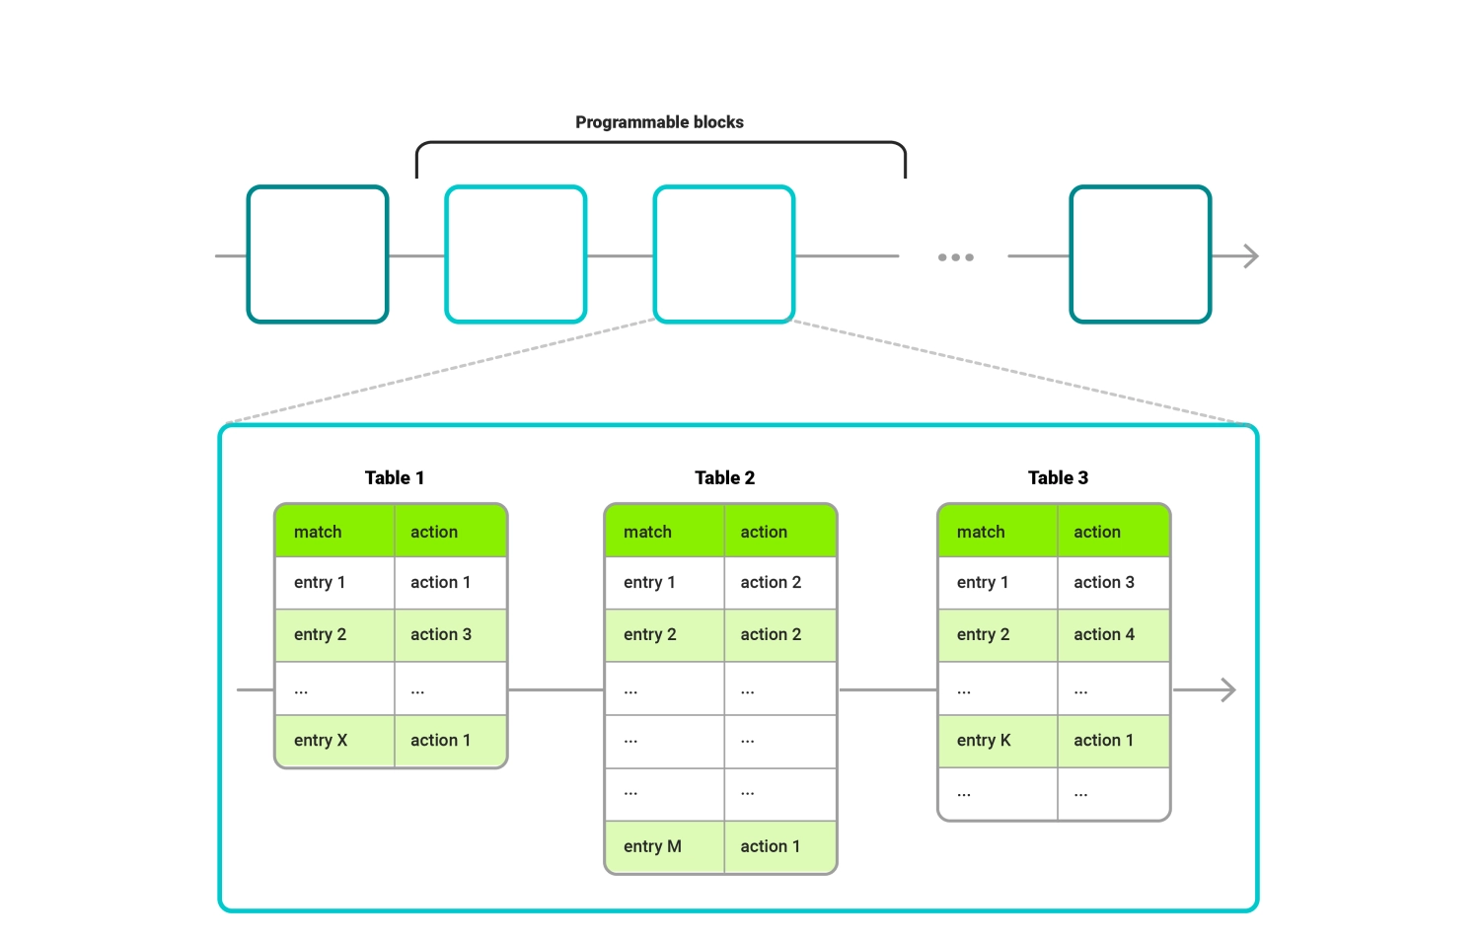
Programming protocol-Independent Packet Processors - P4
Support standard well-known protocol headers and custom protocols
programmer’s responsibility to design a so-called match-action pipeline
Define your own data plane

Slide 6
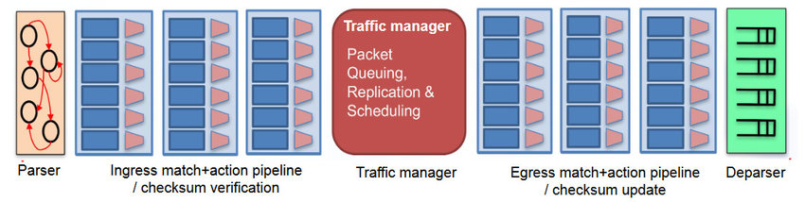
P4 program structure
Architecture(V1model, PSA) define supported functions/metadata in the program and the logical view of the pipeline

Slide 7
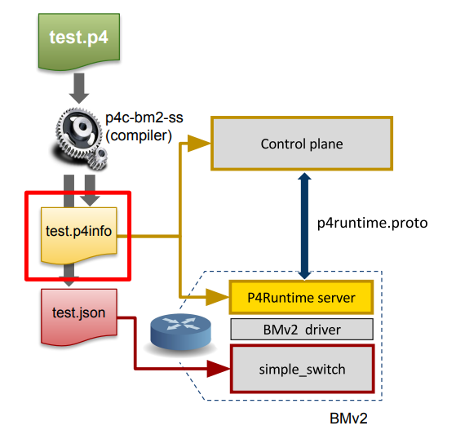
How to run P4 program
Prepare P4 program
Compile it to generate binary file and P4Runtime proto file
Binary file contain our customized data plane logic to run in switch
Proto file allow control plane to insert/modify rules in the data plane through P4Runtime protocol

Slide 8
Learning resources
https://docs.google.com/presentation/d/1SnDqN4WBG88-Fol3x_I-Fy02xa9t9ojWazJ9SCgdgJI/edit?usp=sharing

